Slide 1

Data Driven Education
Discussion Forum Subteam
Presentation 3 - 4/28/2021

Slide 2




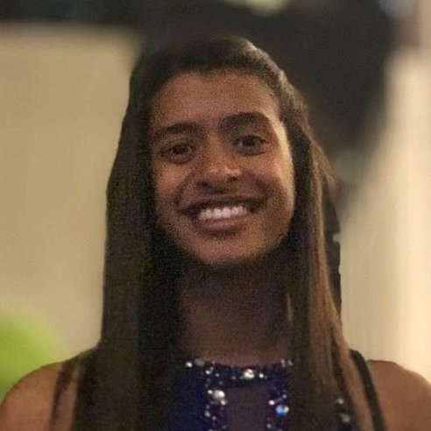
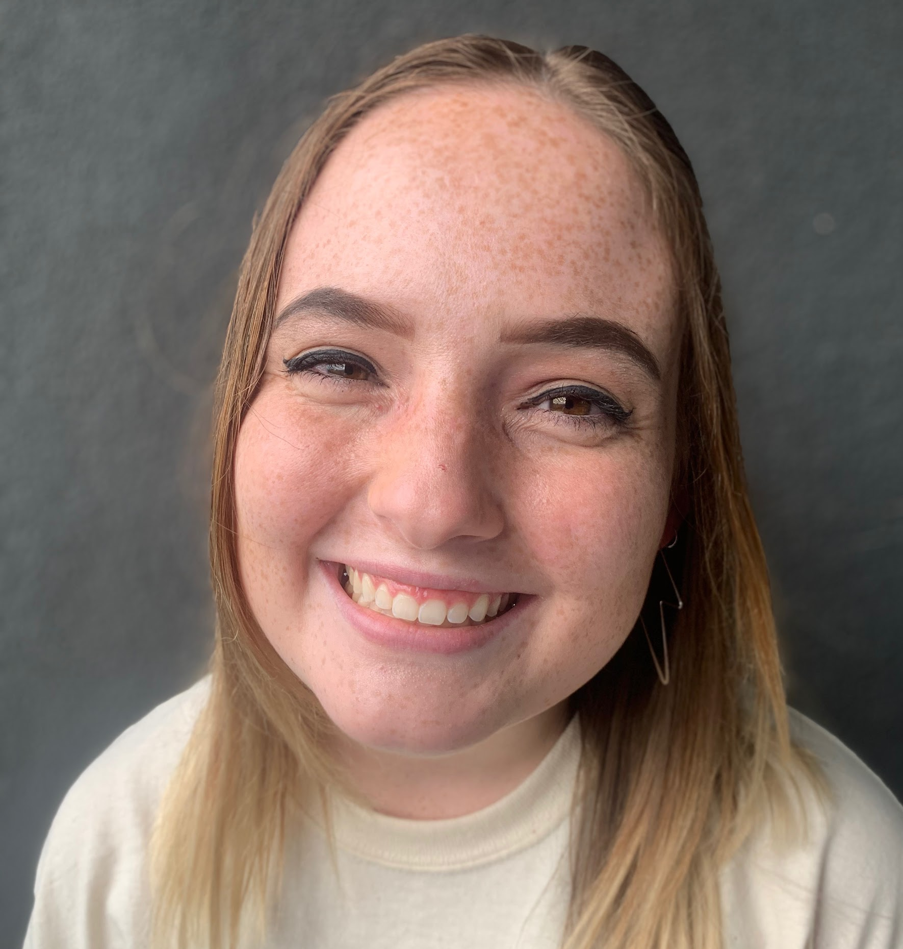
Team Members
Pratik Agrawal
Machine Learning Engineer
Aanya Khandelwal
Back-end
Developer
David Kim
Machine Learning Engineer
Sambhav Jaideep
Front-end
Web Developer
Nidhi Pai
Data Scientist
Morgan Powers
Project Manager
Notes:
All

Slide 3

Introduction
Discussion forums
Student interaction
Goal: Creating a web application to be used by professors will allow the instructors to improve their courses
Notes:
Our project focuses on data from online discussion forums. We want to use this data to look at student interaction. Our goal is to create a web application that will be used by professors that shows them different metrics on student interaction in their discussion forums. With this data, we hope professors can improve their courses.

Slide 4

Meeting with Dr. Joyner
Discussion vs. Q&A
Threading issue
Sampling bias
  Negative vs. positive triggers
When done right, there is more interaction with students online than in person
Casual and organic
Notes:
Last week, we were able to meet with Dr. Joyner who is an expert in the online education field. We specifically discussed discussion forums with him. He said students tend to use discussion forums for either Q&A or discussion. The discussion portion is what presents a lot of challenges.
The main challenge with discussion in discussion forums is threading. Dr. Joyner said threads provide structure to something that is inherently unstructured. Also, the interface of discussion forums can be confusing: it is not clear when a response is expected, who is responding to who, and whether it’s a 1-on-1 conversation or group discussion. Dr. Joyner believes a lot of the threading issues can be solved with fixing the interface.
Dr. Joyner also mentioned there tends to be a sampling bias with discussion forums because certain types of students use discussion forums while other students never use a discussion forum. This is also related to the responses a post get depending on whether it’s positive or negative: negative posts tend to have a larger number of responses than positive posts.
Dr. Joyner also said the most counterintuitive thing about discussion forums is that when they are done right, there tends to more interaction with students online than in person. He also said his favorite thing about the use of discussion forums is how casual and organic they can be.
So, how does this apply to our project? After speaking with Dr. Joyner, our team has a better idea of what professors like and dislike about discussion forums. We want to incorporate this information into our project in future semesters.

Slide 5





Kovanovic 2016 Replication
Feature Extraction
Random Forest Classifier
Spring 2021 Coding Results_Piazza.xlsx
Notes:
For the Kovanovic 2016 replication, we feed in a curated excel file of approximately 1600 examples through two feature extraction applications: 1) Linguistic Inquiry and Word Count 2015 application and 2) Tool for Automatic Analysis of Cohesion. We prune and concatenate the outputs across two sheets and four tables into pandas dataframes that are then fed through the sci-kit learn library: specifically the Random Forest Classifier. While we do not extract named entities of computer science, discussion context features, or use smote to address class imbalance, the initial results are promising at establishing baseline performance for future experiments. In addition, the Coh-Metrix API is not conducive for local experimentation on csv files, so we use Scott Crossley's application TAACO as a substitute.
-David

Slide 6
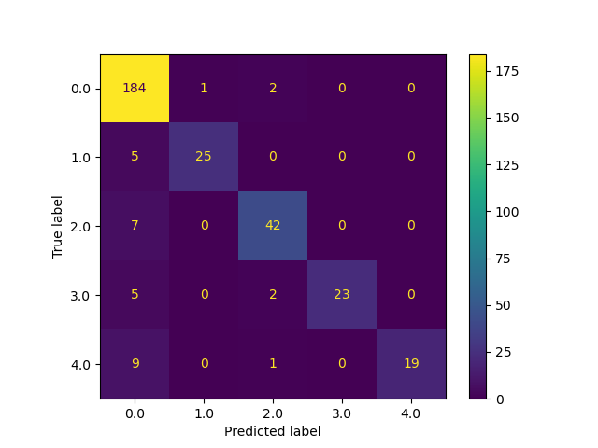
Baseline Performance Results
80/20 Train/Test Split:
Train Accuracy: 0.998
Test Accuracy: 0.902
0 - Other
1 - Triggering
2 - Exploration
3 - Integration
4 - Exploration
Training Time: 0.103s
n_jobs = -1
Ryzen 5600x
Parameters:
n_estimators = 50
max_depth = 50
Notes:
Here we see that with a 80/20 train and test split, we achieving 99.8% training accuracy, and 90.2% test accuracy.
We note non-cognitive presence comments labeled as 0 tend to have the most false positives, but otherwise labeling across all classes is very accurate, with low overlap.
By leveraging parallel computations on modern processors, we find we can train a model with in 1/10 of a second.
With some hyperparameter tuning, we see that having n_estimators of 500 or 5000 get similar performance, but find that 50 estimators with a max depth of 50 gets the best performance with the least amount of training time.
-David

Slide 7
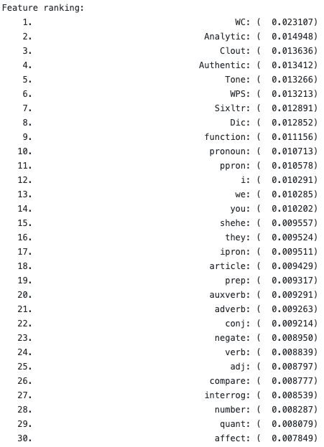
Feature Ranking
Ordered by impurity-based feature importance.
Notes:
Here we see the top 30 features of 259 features that are ranked by impurity. LIWC 2015 features dominate the top 30 features. This differs from Kovanovic's top 20 features, which list coh-metrix features as dominant over liwc. One possible explanation is that the structure of data is different, as piazza posts are too small to properly measure cohesion. An alternative explanation is that TAACO is a poor substitute for coh-metrix.
-David

Slide 8
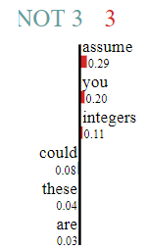

Cognitive Presence modelling with BERT
>80% f1-score on Training set with BERT Fine-tuning using PyTorch
  Mis-classification in test set frequent among adjacent labels
    Need to consider different metrics, since this is Ordinal Classification
    Can try to model it like regression and use metrics accordingly
  Data combination of EdX and Piazza
  Possible improvements: More data, cleaner extraction from Piazza itself (removing code segments etc)
LIME approach to identify impact of individual words
Words impacting the decision of the model
Predicted Class: 3 (with 0.6 probability)
Notes:
We also tried automating cognitive presence labelling with BERT language model and we were able to get a reasonably good performance on the training and test sets. The data was a combination of both EdX and Piazza. In the test set particularly, the model was struggling between adjacent classes though, which makes sense given that the classes have an inherent order to them. A possible workaround is to model it as a regression problem instead, which would be the immediate next step. Meanwhile, to add some interpretability to the model, we used the LIME framework, which helps identify features (in this case, words) that are most influential for the model in making the classification decision. So, for instance, if you see the sentence “you could assume these are integers”, words like “assume”, “integers” are leaning the model towards Class 3 which is a high cognitive presence category, and on the other hand, standard words like “could”, “these” etc. are not. Having this kind of model agnostic framework can be very helpful in confirming or rejecting the validity of these black box models.

Slide 9
Why do we care?
Cognitive Presence Use Cases:
  Confirming understanding of tasks
  Assessing learning strategies and work processes and/or proposing corrections to those processes
  Reminding others of tasks and encouraging them to focus on or contribute to tasks, resources, and activities
  Helping with tasks, processes, or products of learning
  Managing the movement through learning phases or tasks
https://canvas.ucdavis.edu/courses/34528/pages/types-of-presence-cognitive-and-social-presence
Notes:
So why do we care?
The benefits of automated cognitive presence will enable teachers to develop more detailed summaries of their students understanding of topics as they progress through the curriculum. The hope is that with this granular view, teaching staff can quickly identify struggling students and address their specific needs.
-David

Slide 10
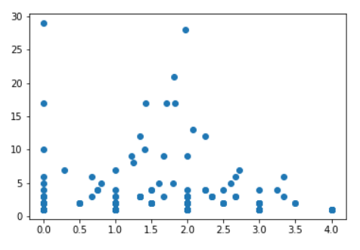
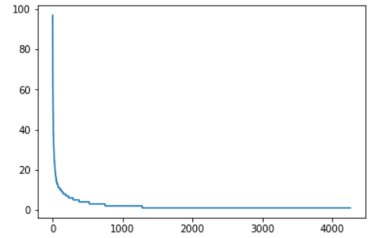
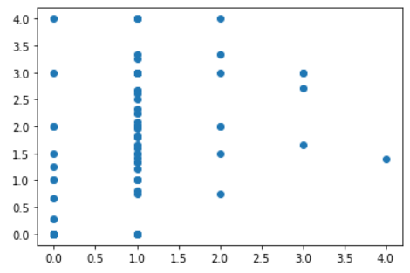
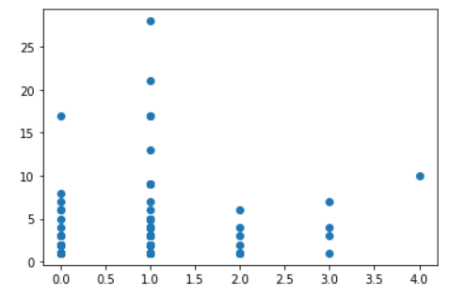
Social dimension of Cognitive Presence
Number of comments
Posts made by user
Users in sorted order
Mean Cognitive presence - Comments
Mean Cognitive presence - Comments
Number of comments
Cognitive presence - Original post
Cognitive Presence - Original post
Notes:
Another interesting thing where we can use cognitive presence labels is to understand the quality of social interactions happening in the class. The quantity is also something concerning from our data though. If you see the plot on the top left, which shows how many posts were made by each user in sorted order, you can clearly see the skew. Most of the users are not engaging with the discussion forums, and only a select few are responsible for most of the volume, which clearly shows there are gaps to be filled. If we talk about quality, and how much does the cognitive requirement of getting involved in a discussion impacts the extent of discussion, which we have tried to model using cognitive presence scores of the original post and the mean of the comments, from the plots on the right, one can observe 2 things atleast. 1. Most threads do not go beyond 10 comments, and 2. the ones that do, are typically triggers or posts with no cognitive presence like the intro threads and greetings. Additionally if we look at the plot on bottom left, which is an attempt at comparing the cognitive engagement levels in the comments as a function of the original post, we can notice that while threads with low cognitive presence can see the entire spectrum of cognitive engagement, the ones which started high tend to get comments also more focused and in the high cognitive range. An ideal scenario would be having high volumes in these high cognitive presence areas.

Slide 11
Challenges and research questions to explore
Discussion forums study in isolation has a large sampling bias:
  We’re only considering students who actively participate in the forums
  Ideas to explore further:
    Threads talking about frustration regarding a particular course aspect seem to achieve highest participation if that sentiment is shared by many students
    Hard to know when to get involved in discussion in an asynchronous forum
      The design of Piazza makes it even harder. Reddit is better in that regard
    Triggers that can help initiate meaningful discussions
      Peer-feedback is one example, Polls by instructors can be another
    Higher cognitive engagement in forum discussions potentially isolating for students facing difficulty with the course. Potential ways to make these threads more inclusive.
  Need to engage more actively with instructors and course designers to identify next steps
Method of data collection needs to be improved:
  Code segments and other unnecessary parts should be removed using tags.
  Can take suggestions from the PARQR team
Notes:
All this analysis so far highlights 2 important points, as well as research questions worth exploring further. Most of these are inspired from the discussion we had with Dr. Joyner. The first concern/challenge is the high sampling bias. We’re totally missing out on the students who are present in the course but not interacting on the forums, which seems to be quite a sizeable chunk from our current study. A way to possibly include them as well would be to study discussion forums not in isolation, but with other data streams including the assessments and platform interactions. At the same time, for our analysis to have anything actionable, we need to first fix the data collection at the source itself. Currently, irrelevant parts like code segments, missing thread ids and tags, make the analysis and the predictions difficult and lead to unnecessary replication of steps. To mitigate this, we’re thinking that taking ideas and suggestions from the PARQR team could be helpful. In terms of the questions to be explored, there are 4 listed here for now, ranging from Sentiment analysis of threads and their impact on social presence, to identifying ways to make discussion forums more inclusive for the people who’re being left out, and at the same time, find meaningful triggers that can help initiate these discussions. For this we need to more actively engage with instructors and course designers. For a start, we conducted a survey with some instructors which Nidhi will be talking about next.

Slide 12
Survey Results
Survey composition:
26 responses, 4 lead instructors and 22 TA’s
17 responses are TAs from CS courses (CS 1301, CS 1332, CS 2340, CS 3510, and CS 4510)
Use cases of metrics from Piazza:
Identifying students who contribute often with good posts as potential TAs, to give bonus points, or as a participation grade
Identifying struggling students with questions each week
Finding common topics that students are struggling with
Gauge of class activity & morale
Increasing instructor presence and distributing workload across TAs
Notes:
we got more responses from the survey
these are categories of metrics and the use cases of Piazza -> goals of our dashboard
explain metrics
Nidhi

Slide 13
Visualization & Metric Ideas
Identifying students who contribute often with good posts as potential TAs, to give bonus points, or as a participation grade
  Create a customizable “participation score”
  Display students with the highest participation score
  Visualizations: Number of posts by user, cognitive presence by user, posts viewed by user, participation score by user
Identifying struggling students with questions each week
Finding common topics that students are struggling with
  Trending topic for this week
  Links to posts with the most “good question marks”
  Number posts by folder
Notes:
-Nidhi

Slide 14
Visualization & Metric Ideas (contd.)
Gauge of class activity & morale
  Posts over time
  Sentiment over time
  Percentage of students that are always/sometimes/never active
Increasing instructor presence, distributing workload among TAs
  Number of posts answered by each TA
  Instructor response time by TA
Notes:
-Nidhi

Slide 15
Challenges and Next Steps
Challenges:
Survey would have ideally been done earlier in the semester
Disconnect between what professors and researchers want to know - metrics relevant for research may not be useful for instructors
Next steps:
Diversify sample for survey, conduct interviews
Narrow down what metrics are useful
Start implementing some metrics on the frontend
Notes:
-Nidhi

Slide 16
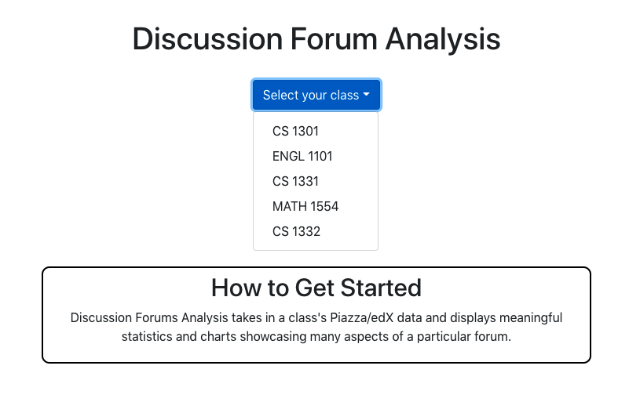
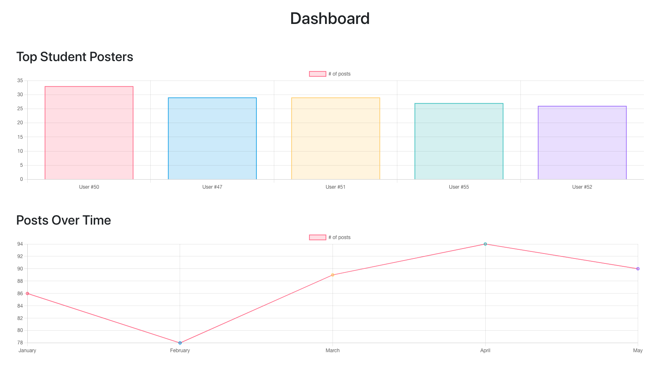
Web-Dev Team
Progress:
Completed demo!
  First iteration of web-app
Challenges:
Learning curve
  Many moving parts
Setting goals
  Too ambitious vs. setting bar too low
Next Steps:
Integrate real data
Interview more professors
Refine core features
  Plan advanced features

Slide 17
Back-End Development
Learning curve during first sprint
  Connect Python to React (front-end)
  Use Flask
  Connect Flask with SQLAlchemy
Established a working pipeline for data transmission
  Used dummy data
More research and data was required - needed some inter team collaboration
  Understanding of what the data science team was doing and what data they were working with so it could be pushed through the pipeline
  Currently working with raw data but eventually need to connect it to Piazza and other platforms
Formalised goals for the next sprint
  New learning period

Slide 18
Conclusion
Met with Dr. Joyner
Data science
  "Replicated" Kovanovic 2016
  Automate the process of labelling cognitive presence to a high degree
  Identified future research questions to be explored,
  Assessed the survey results
Web development
  Working demo
  Established pipeline for data transmission
Notes:
To conclude, this sprint we were able to meet with Dr. Joyner. The data science team replicated Kovanic 2016 which resulted in a model with high accuracy for labeling cognitive presence, demonstrated that it’s possible to automate the process of labelling cognitive presence to a high degree of ML models, identified future research questions to be explored to understand the social dimension of interactions in a class, and assessed the survey results. The web development team created a working demo and established a pipeline for data transmission.

Slide 19
Citations
Kovanovíc, V., Joksimovíc, S., Waters, Z., Gaševíc, D., Kitto, K., Hatala, M., & Siemens, G. (2016). Towards automated content analysis of discussion transcripts: A cognitive presence case. ACM International Conference Proceeding Series. https://doi.org/10.1145/2883851.2883950

